Slide 1


Slide 2
WHAT IS OM?
Operation Mobilisation, tracing back to the 1950s, is a disciple-making movement striving to make Jesus known everywhere – with a particular focus on “least-reached” populations.
4500
147
2
OM workers
worldwide
Countries in which OM serves
Ships sailing
the globe

Slide 3

WHAT IS OM’S SHIP MINISTRY?
OM’s Ship Ministry shares knowledge, help and hope around the world through their 2 ships Logos Hope & Doulos Hope. The ministry disciples Jesus followers to share the life-changing message of the Kingdom of God.
1m
Visitors per year
30
Ports per year

Slide 4
Download and add the video here: https://vimeo.com/1192276389/246ae875bb

Slide 5
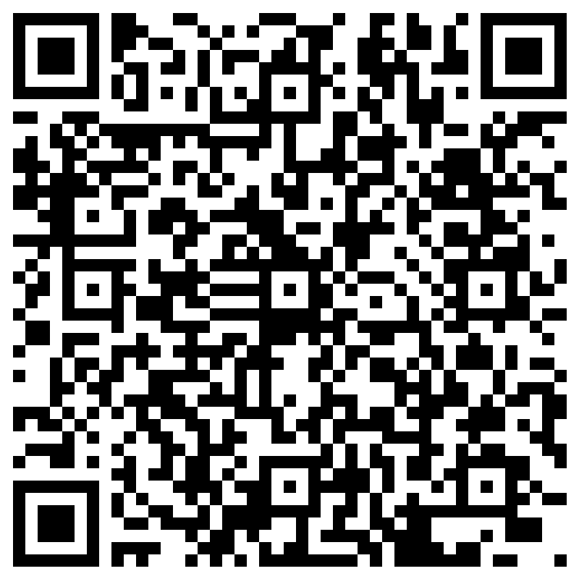

HOW CAN YOU GET INVOLVED?
📖 Visit the bookfair & Hope Café
🎟️ Attend an onboard event
🔍 Take a guided tour of Logos Hope
🤝 Volunteer with us!
🙏 Pray

Slide 6
THANK YOU!
WWW.OM.ORG/IE/LOGOSHOPE2026

